Slide 1
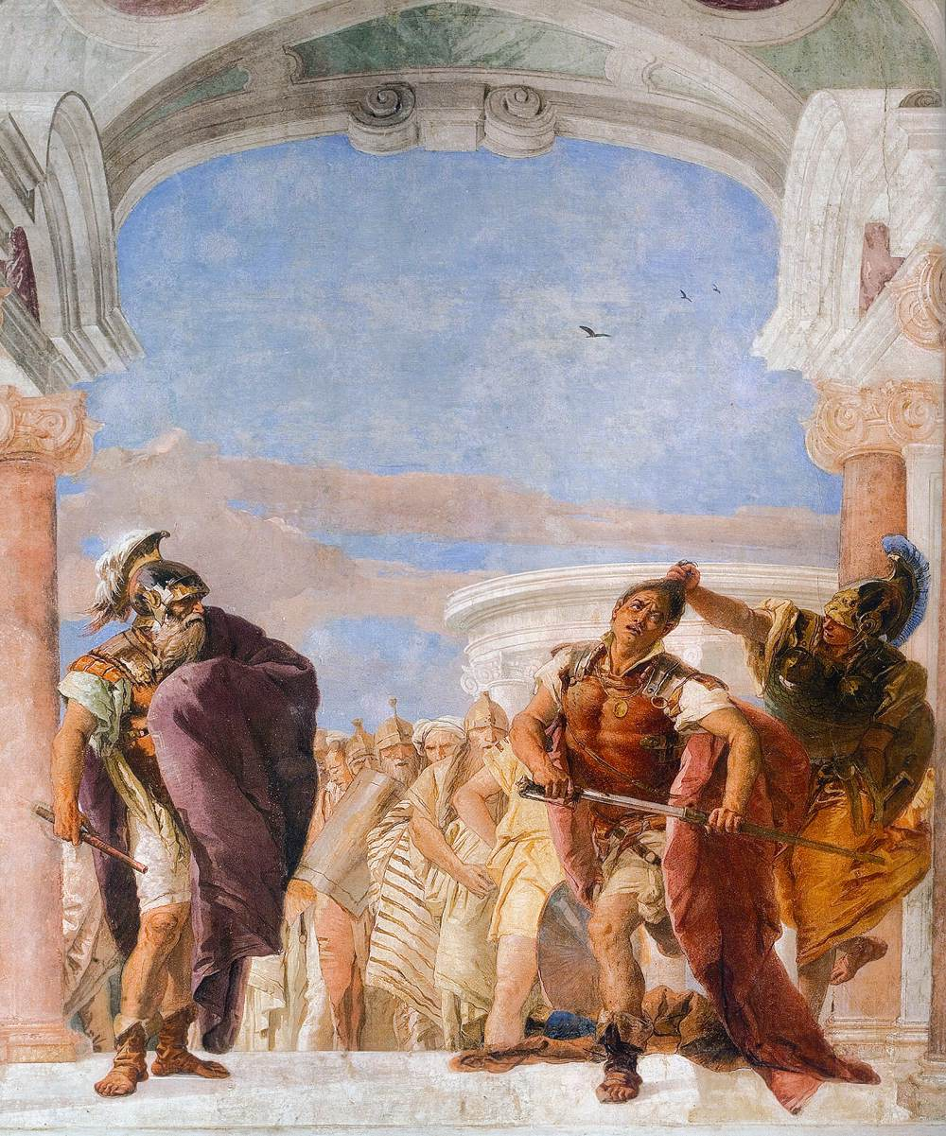
From
Amicable Understanding to
Tear him from Limb to Limb!
Anger & Reason in the English Coal Lock-out of 1893
Quentin Outram, University of Leeds, UK
qo@lubs.leeds.ac.uk
Notes:
Cover: Minerva trattiene Achille dall'uccidere Agamennone [Minerva [Athena] restrains Achilles from killing Agamemnon], known in English as The Rage of Achilles (detail), Tiepolo, 1757. A fresco at the Villa Valmarana ‘Ai Nani’, Vicenza. The painting depicts the scene in Homer’s Iliad showing the confrontation between King Agamemnon (left) and Achilles (right), when the enraged Achilles draws his sword from his sheath as he contemplates killing Agamemnon but is restrained by the goddess Athena, known to the Romans as Minerva, who seizes him by his hair (The Iliad, book 1, lines 119-372, at line 232). Often interpreted by translators and commentators as an example of Homer’s use of godly intervention to metamorphose and externalize internal mental and emotional conflicts (George Chapman, Alexander Pope), Barbara Koziak has suggested that Homer saw no split between emotion and reason (‘Homeric Thumos: The Early History of Gender, Emotion, and Politics’, Journal of Politics, 61(4), November 1999, pp. 1068-91, at p. 1077.

Slide 2

This talk was fist presented at the Emotions in Conflict Conference, organized by the Society for the History of the Emotions of Australia, at the University of Ottawa in October 2019.
I’d like to thank the participants in that conference, particularly Mark Cells, Jim Jaffe, Claudia Jarzebowski, and Susan J Matt, for their comments and amity. The usual disclaimer applies.

Slide 3
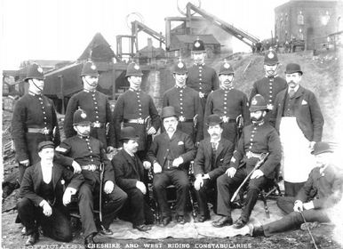
The Conflict:
A Lock-out
Miners’ Federation of GB vs. Owners
Big: about 300,000 miners involved
Long: 28 July to 17 November, 16 weeks
Disturbances: August onwards
Featherstone Massacre: September
Officials of the Cheshire and West Riding Constabularies
Notes:
Photo: ‘Police with colliery officials on duty at Tankersley colliery during the 1893 strike. © National Coal Mining Museum for England. Available online at the World Wide Meta Museum website (http://www.wwmm.org/storie/storia.asp?id_storia=215&pagina=1). Tankersley is just north of Barnsley in what is now known as South Yorkshire. On the 28 July 1893 miners in Lancashire, Yorkshire, Derbyshire, and Nottinghamshire ceased work and brought their tools to the surface in a long-foreshadowed attempt to forestall a cut in wage rates. The next day they were joined by miners in Staffordshire, Warwickshire and Worcestershire. Eventually some 300,000 miners were involved in what was then the largest industrial dispute ever known. For this background see R. P. Arnot, The Miners: A History of the Miners’ Federation of Great Britain 1889-1910 (George Allen & Unwin: 1949), pp. 219-65; J. E. Williams, The Derbyshire Miners: A Study in Industrial and Social History (George Allen & Unwin: 1962), pp. 314-43); R. G. Neville, The Yorkshire Miners 1881-1926: A Study in Labour and Social History (unpublished Ph.D. dissertation, University of Leeds, 1974), pp. 175-237; and Carolyn Baylies, The History of the Yorkshire Miners 1881-1918 (Routledge: 1993) pp. 95-130.

Slide 4
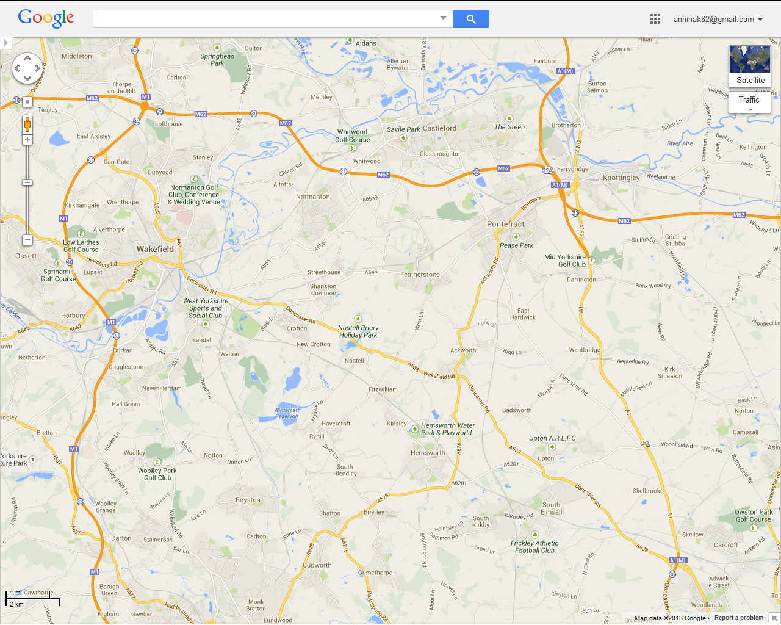
Where is Featherstone?
M1
Leeds
A1
The North
Castleford
M62
to Hull
Normanton
Pontefract
Wakefield
●
Featherstone
M1 to Barnsley,
Sheffield
& The South
A1 to Doncaster
& The South

Slide 5
Two Issues
1. Why did the conflict turn violent?
2. If emotions turned the conflict violent, what happened to reason?

Slide 6
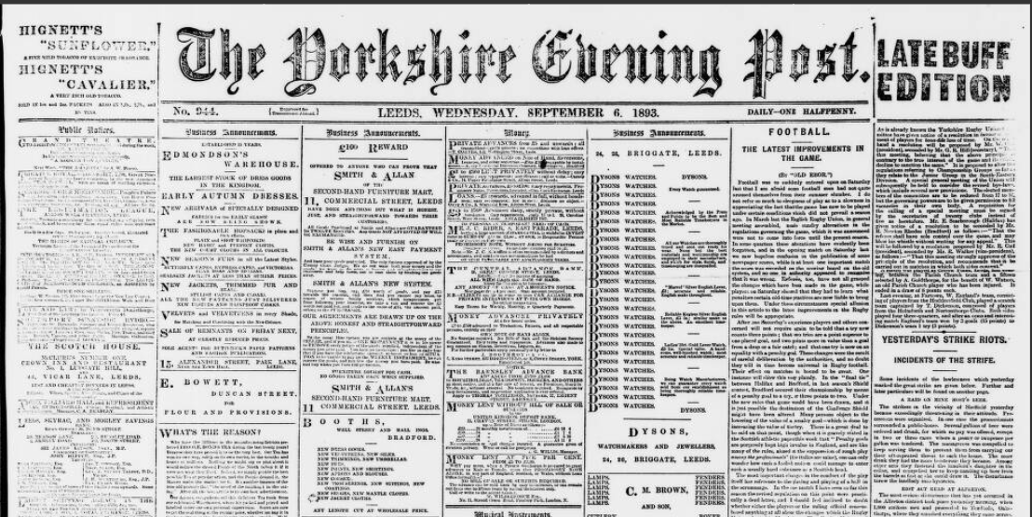
But Why Look at this Conflict?
Good Quality Multiple Sources:
Newspaper accounts
Evidence at an Inquest
The depositions gathered by the
Treasury Solicitor’s Department
Evidence at the Committee of Inquiry
Sam Wood’s account
Sometimes from participants or witnesses
Sometimes pseudo-verbatim
Notes:
The Yorkshire Evening Post, Leeds, 6 September 1893 on the eve of the ‘Featherstone Massacre’. From the online database, the British Newspaper Archive (British Library / Findmypast).
The Committee of Inquiry issued a Report (Report of the Committee Appointed to Inquire into the Circumstances Connected with the Disturbances at Featherstone on the 7th of September 1893, C.—7234, HMSO, 1893) and a volume of Minutes and Appendices (Minutes of Evidence (With Appendices) taken before the Committee Appointed to Inquire into the Circumstances Connected with the Disturbances at Featherstone on 7th September 1893, C.—7234-I, HMSO, 1893. The Committee was chaired by the Rt. Hon. Lord Bowen. It was appointed on 5th October 1893 and reported on 6th December the same year. In what follows the Report and the Minutes of Evidence are referred to as ‘Bowen, Report’ and ‘Bowen, Minutes’, respectively.

Slide 7
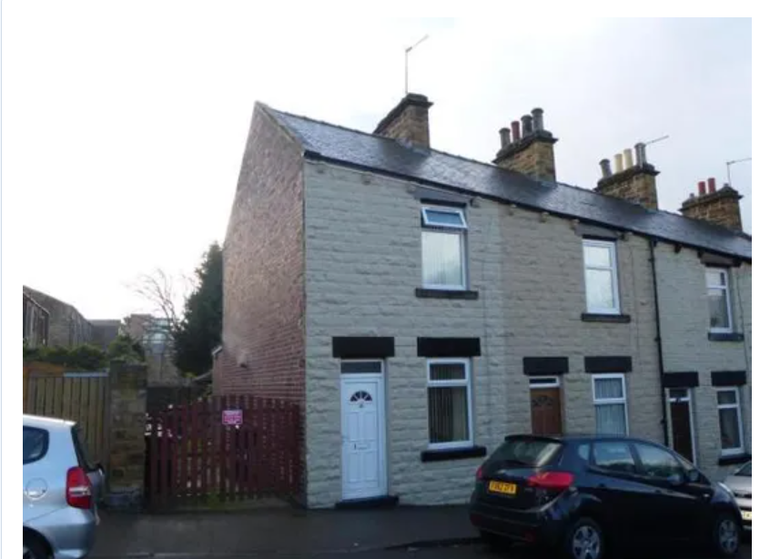
Sam Wood, the Working-Class Author
of The Battle of ‘93
In 1893, a 31 year-old boiler-maker and holder-up, living at 4 Keir Street, Barnsley. His father was a colliery banksman;
his brother Charles was a colliery labourer.
Nos. 2 (left), 4 (middle), and 6 (right), Keir Street, Barnsley, as they are today.
Next door neighbours:
No.2: Alfred Broadhead, a linen warehouseman;
No. 6: John Swift, a coal miner.
Notes:
Photo from themovemarket.com. Census and vital registration records show Sam Wood to have been born in 1861 in Hoyland Common, a coal and ironstone mining village just south of Barnsley, to Jane and Charles Wood. At the time of Sam’s birth, Charles was a banksman at an iron pit, i.e. someone responsible for unloading the ironstone as it came to the surface; by 1881 he was doing a similar job at a coal mine and remained a colliery banksman until at least 1891. By this time Charles Wood, Jr., Sam’s younger brother, was working as a colliery labourer; his elder brother, Jabez, had died in 1878 at the age of eighteen. Sam married Ann (or Annie) Helen (or Ellen) Matthewman in Barnsley in 1879. She was born in Sheffield, also in 1861, the daughter of Mary and William Matthewman, Mary a milliner and dressmaker, and William an engine driver; William Matthewman died in 1869 when he was only 37 and Ann was only 8. Sam and Ann had five children of whom four died young.
Sam Wood was working as a coal miner at Hoyland Common, south of Barnsley, in 1881 but by 1891 was describing himself as ‘Boiler maker Holder up Author’, a ‘holder-up’ usually denoting a member of a riveting team. He was living in Keir Street, Barnsley, a short terrace of stone-fronted, brick and slate houses which still stands and which suggests, if one mentally strips away modern extensions and inside bathrooms, cramped and uncomfortable living conditions. He lived here until his death in 1927. In 1891 his next door neighbour on one side was a coal miner, on the other a ‘Linen warehouseman’. It is thus likely that he witnessed the effects of the lock-out on the health and mood of Barnsley miners, amongst whom were his father and brother, at first hand. His work is valuable since it is likely to be based on direct observation and it is the only extant, connected account from a local and working-class hand.

Slide 8
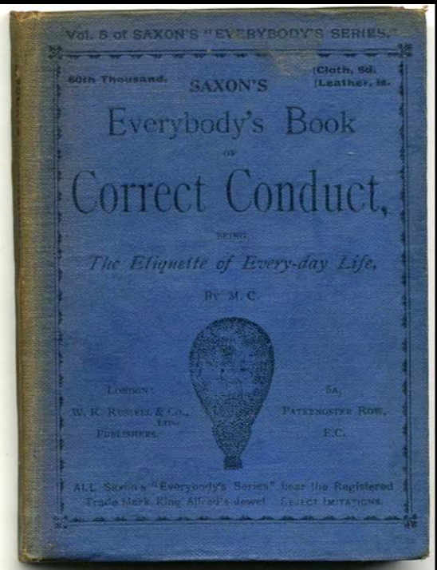
‘M.C.’ [M. Caudle?], Everybody's Book of Correct Conduct, Being the Etiquette of Every-day Life.
Published by W.R. Russell & Co.
(Saxon's Everybody's Series.) 1893
(Photo from Jarndyce, The 19th Century Booksellers)
Not conduct books

Slide 9
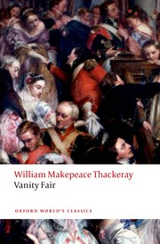
Not fiction
Notes:
Photo from the Amazon.com website; book design by Oxford University Press.

Slide 10
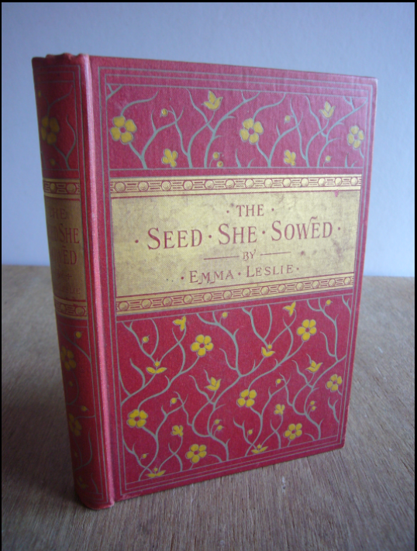
Nor fiction
Notes:
Emma Leslie, The Seed She Sowed: A Tale of the Great Dock Strike. Published by Blackie & Son, 1900. (Photo from SoIn2Books via the Abebooks website: Abebooks.co.uk).

Slide 11
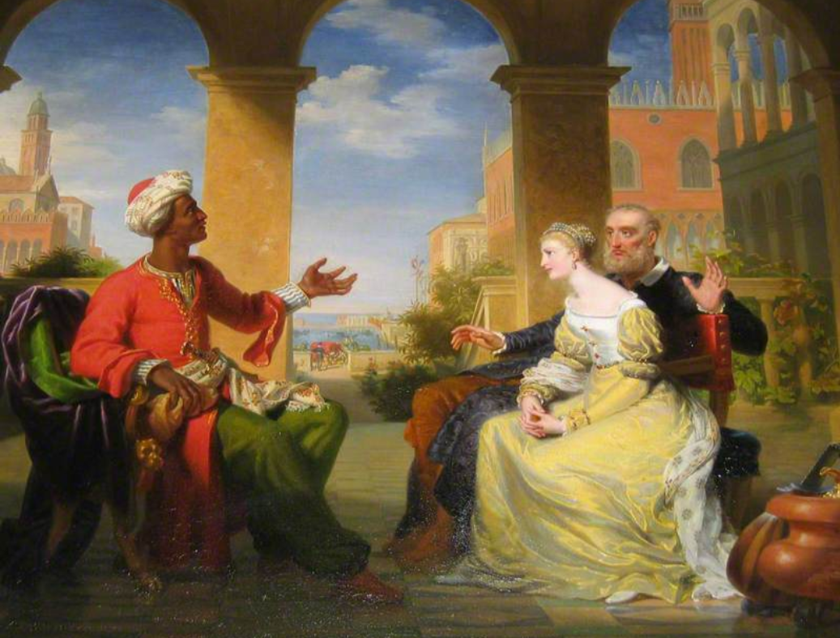
Henri Jean-Baptiste Victoire Fradelle (1778–1865),
'Othello', Act I, Scene 3, Othello Relating His Life Story to Desdemona c.1823–1824.
Photo credit: François Grosjean. Royal Shakespeare Company Collection
Narrative

Slide 12
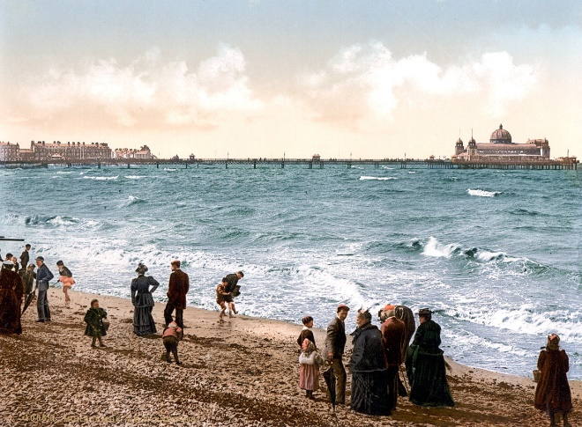
Late July and early August:
‘There’s not much temper .... All seem to accept the situation calmly and deliberately ….’
‘light-hearted indifference’
Notes:
Photo: ‘The pier at Morecambe, 1869, a beguiling, Victorian pleasure pavilion.’ Image courtesy of Richard Grange / Alamy via Catharine Slessor, ‘Typology: Pier’, The Architectural Review, 15 April 2019. Online at: https://www.architectural-review.com/essays/typology/typology-pier/10041555.article (accessed 26 September 2019). At the beginning of the lock-out a Yorkshire checkweighman was asked ‘What is the feeling on the subject?’ and gave the answer:
‘There’s not much temper, although we feel we are being unjustly treated. All seem to accept the situation calmly and deliberately, and no alarm exists at the present.’ Pontefract and Castleford Express, 29 July 1893. The Leeds Mercury remarked as the lockout began that:
‘there is no bitterness of feeling …. Seldom has a crisis like the present culminated with so amicable an understanding between the parties. It would seem that it is, to quote the most recent diplomatic phrase, a ‘pacific blockade’ of the mines that is intended.’
The Barnsley Chronicle wrote that ‘both sides mean fighting, but they begin on friendly terms, and, reciprocating the good feeling which the men have shown’ it had been arranged that the men’s tools should remain down the pits with the implication that all would be able to return to their old places at the end of the dispute. Sam Wood, a working-class writer of Barnsley, noted also that the miners had been allowed to remain in their colliery houses instead of being threatened with eviction as had happened in previous disputes. The local Featherstone newspaper remarked that the mid-August Featherstone Feast was as ‘brisk and frolicsome’ as ever. One miner, recently returned with his family from a holiday in Southport cheerfully told the reporter that if the strike did not end soon he would take his family off for another fortnight’s holiday, this time to Scarborough. But underneath this air of ‘light-hearted indifference’ was a determined confidence. ‘The men entertain little fear that in the end they will [not] come off conquerors, and there seems a very determined feeling amongst them that they will not give in whatever may be the results’. (‘The Coal Trade Crisis’, The Leeds Mercury, 29 July 1893, p. 3d. The reference is to France’s threat during these days to blockade Siam (now Thailand) which was allegedly ‘pacific’ because it was to be directed only at Siamese ships; ‘The Coal Trade Crisis’, The Barnsley Chronicle, 29 July 1893, p. 8a; Sam Wood, The Battle of ’93: A Descriptive Record of the Great Coal Strike (Neale Bros., Barnsley, n.d.), p. 8; ‘Featherstone’, Pontefract and Castleford Express, 19 August 1893, p. 8d. The Barnsley Chronicle also remarked that the trains were full of miners going to seaside holidays (‘The Coal Trade Crisis’, The Barnsley Chronicle, 5 August 1893, p. 3a). Wood wrote similarly (The Battle of ’93, p. 9). Sheffield & Rotherham Independent, 1 August 1893, ‘Sheffield: The Midland Company and the crisis’: ‘Hundreds of miners are walking about Sheffield, yesterday, enjoying the respite from their subterranean toil in the innocent and inexpensive recreation of looking in shop windows.’

Slide 13
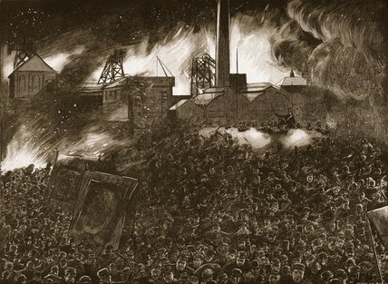
September: A violent disturbance at Ackton Hall Colliery, Featherstone
Troops deployed.
James Duggan, James Gibbs shot dead;
at least 9 others wounded by troops.
The Featherstone Massacre

Slide 14
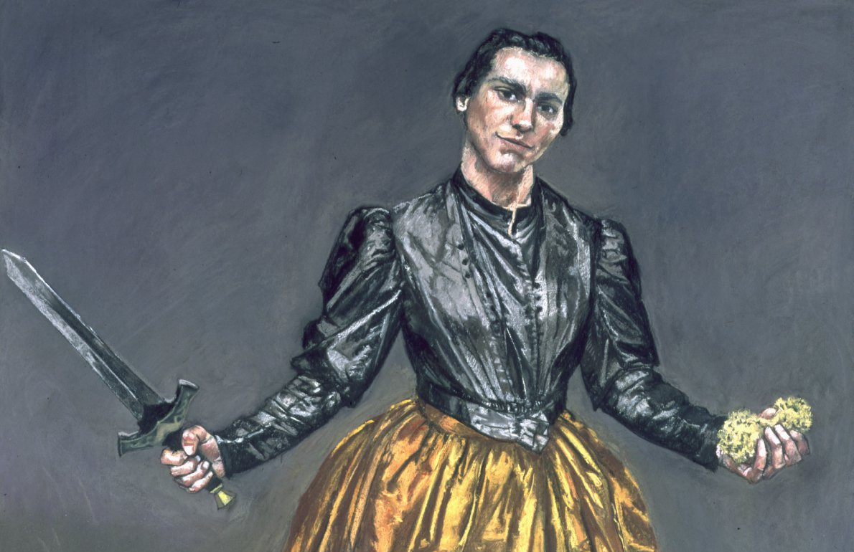
Why this Transformation?
Paula Rego, Angel, 1998. Reproduced in Anthony Spira and Catherine Lampert (eds.), Paul Rego: Obedience and Defiance, Art/Books, 2019.
Working Assumptions
Violence preceded by anger.
Anger induced by bodily or mental distress
(pain, hunger, drunkenness)
or provoked by insults.

Slide 15
Anger & Reason

Slide 16
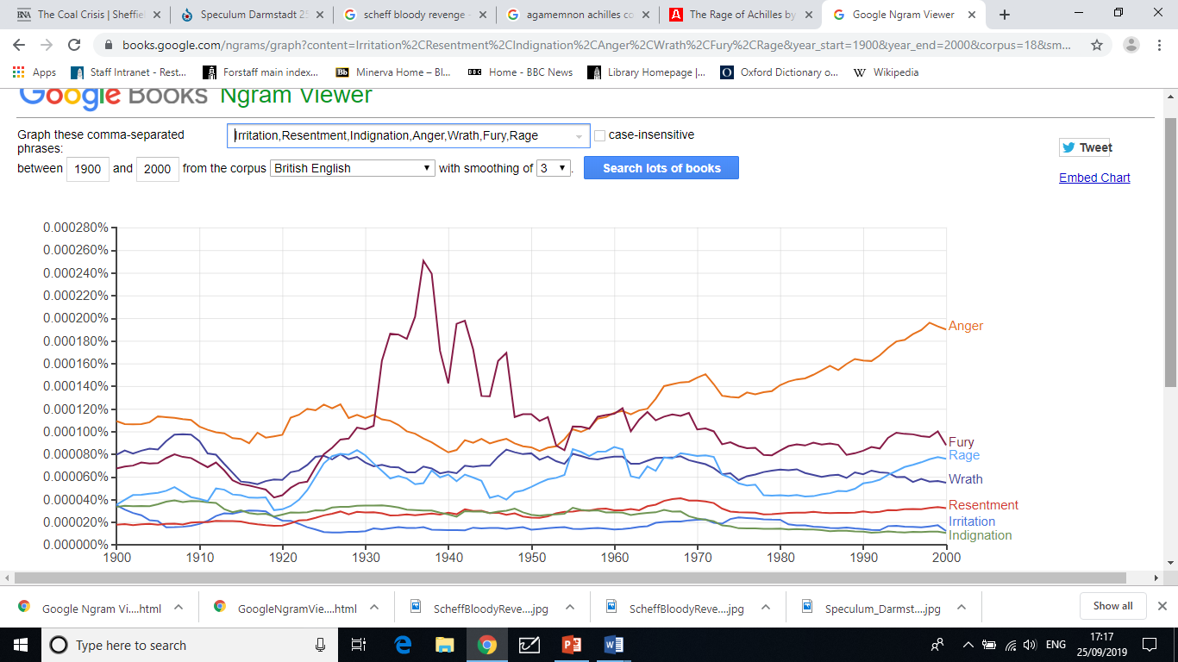
A Loss of Nuance in Talk of Anger?
The vocabulary is extensive:
  Irritation, Resentment, Indignation,
  Anger, Wrath Fury, Rage
But usage is increasingly dominated by ‘Anger’. See Google’s count of Ngrams:
Anger
1900 1950 2000
Notes:
Ngram counts are from the corpus ‘British English 2012’; they are of occurrences of ‘ngrams’ (broadly, words) in books published in Great Britain, smoothed by computing three-year moving averages. (Jean-Baptiste Michel, Yuan Kui Shen, Aviva Presser Aiden, Adrian Veres, Matthew K. Gray, William Brockman, The Google Books Team, Joseph P. Pickett, Dale Hoiberg, Dan Clancy, Peter Norvig, Jon Orwant, Steven Pinker, Martin A. Nowak, and Erez Lieberman Aiden, ’Quantitative Analysis of Culture Using Millions of Digitized Books’, Science. (Published online ahead of print: 12/16/2010). Counts of word occurrences in the British Newspaper Archive (British Library / Findmypast) give similar results. The count of the ngram ‘Anger’ is 38% of the sum of the counts of ‘anger’, ‘fury’, ‘rage’, and ‘wrath’ in 1900; 26% in 1950, and 47% in 2000).

Slide 17
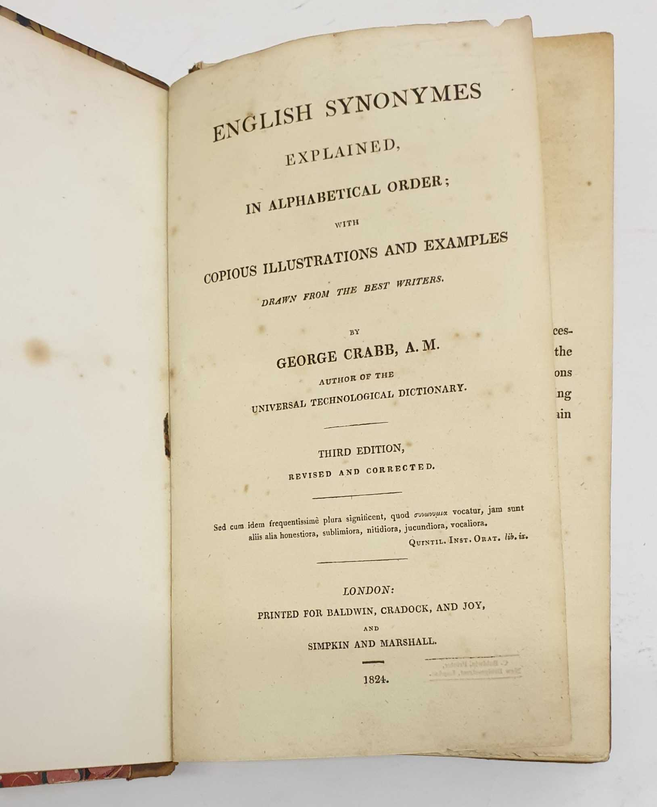
Crabb’s English Synonymes. 3rd edn. 1824
Notes:
Image from the website of Maynard & Bradley, booksellers, Leicester, UK, 10 August 2021.

Slide 18
Distinctions according to
Crabb’s English Synonymes (1816)
Anger vs. Wrath
Wrath is:
‘more vivid’,
‘unbending pride’ is often the source;
the ‘sentiment of a superior to an
inferior’;
‘unjustifiable between man and man’;
for God, only
Notes:
George Crabb, English Synonymes [sic] Explained: In Alphabetical Order with Copious Illustrations and Examples Drawn from the Best Writers. London : Printed for Baldwin, Cradock, and Joy and T. Boosey, 1816. George Crabb (1778-1851) was an English school teacher and later a barrister who eventually became a recluse. There were further English editions in 1818, 1824, 1826, 1829, 1837, 1844, 1846, 1850, 1859, 1864, 1875, 1884, 1888, 1892, 1893, 1898, 1904, 1916 (revised), 1920, 1966, and 2017. It was thus a standard book of reference until at least the First World War.

Slide 19
Distinctions according to
Crabb’s English Synonymes (1816)
Anger vs. Rage vs. Fury
Show a progressive force
Rage, from Latin, rabies, ‘madness’
Fury, from Latin, feror, ‘to carry away’
The Greek and Roman Eumenides or Furies came from Tartarus,
lower even than Hades.
So Wrath is Olympian,
Fury is hellish

Slide 20
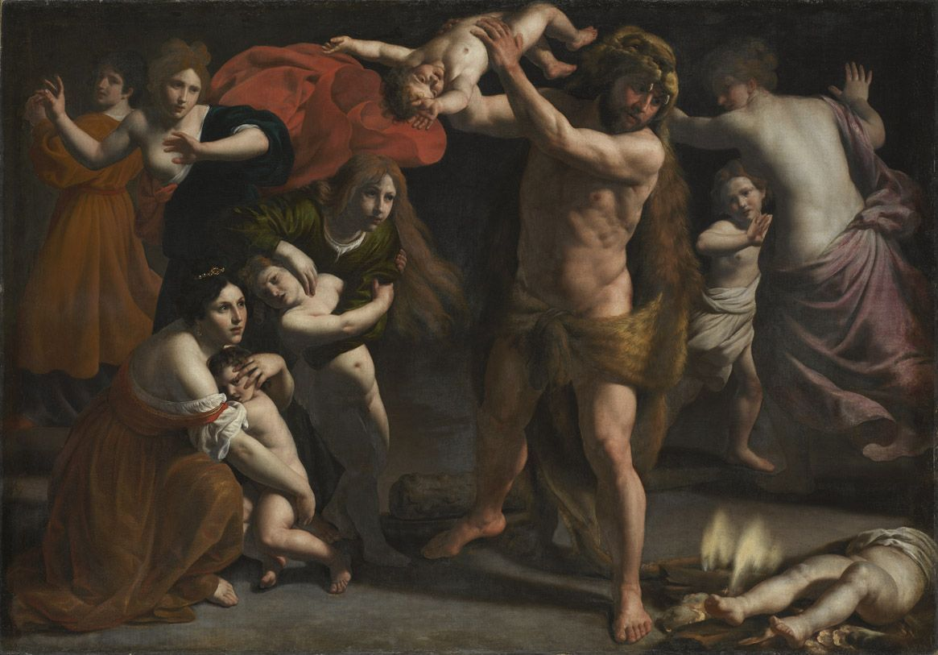
The Rage of Hercules
Alessandro Turchi, c. 1620s
In a fit of madness
Hercules kills his wife and children.

Slide 21
Distinctions according to
Crabb’s English Synonymes (1816)
Anger vs. Rage and Fury
‘Anger may be so stifled as not to discover itself by any outward symptoms; … rage breaks forth into extravagant expressions and violent distortions; fury takes away the use of the understanding.’
Anger is compatible with reason, fury is not; rage distorts reason.

Slide 22
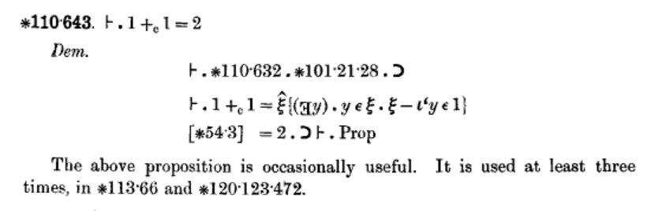
Reason
Models of Reason
A. Mathematics: 1+1=2
Alfred North Whitehead and Bertrand Russell, Principia Mathematica, 3 volumes, Cambridge, Cambridge University Press, 1910, 1912, 1913, Vol. II, p.86.
Too demanding for instances involving ordinary people.

Slide 23
Reason
Models of Reason
B. Logic
All people are mortal.
Socrates was a person.
Therefore Socrates was mortal.
Simple examples lack application to historical episodes of interest.
Notes:
Adapted from John Stuart Mill, A System of Logic, Ratiocinative and Inductive, Being a Connected View of the Principles of Evidence, and the Methods of Scientific Investigation, 3rd ed., vol. 1, chap. 2 (London: John W. Parker, 1851), p. 190.

Slide 24

Reason
Models of Reason
C. Argumentative Theory
Hugo Mercier and Dan Sperber
“Our hypothesis is that the function of reasoning is argumentative. It is to devise and evaluate arguments intended to persuade.”
Notes:
Portrait of Dan Sperber, Paris, December 2012. Photo by Jean-Luc Jucker, (Creative Commons Attribution-Share Alike 3.0 Unported Licence). Hugo Mercier (Philosophy, Politics and Economics Program, University of Pennsylvania) and Dan Sperber (Jean Nicod Institute (EHESS-ENS-CNRS); Department of Philosophy, Central European University, Budapest, Hungary), ‘Why do humans reason? Arguments for an argumentative theory’, Behavioral and Brain Sciences, 2011, 34, pp. 57 –111. Abstract: Reasoning is generally seen as a means to improve knowledge and make better decisions. However, much evidence shows that reasoning often leads to epistemic distortions and poor decisions. This suggests that the function of reasoning should be rethought. Our hypothesis is that the function of reasoning is argumentative. It is to devise and evaluate arguments intended to persuade. Reasoning so conceived is adaptive given the exceptional dependence of humans on communication and their vulnerability to misinformation. A wide range of evidence in the psychology of reasoning and decision making can be reinterpreted and better explained in the light of this hypothesis. Poor performance in standard reasoning tasks is explained by the lack of argumentative context. When the same problems are placed in a proper argumentative setting, people turn out to be skilled arguers. Skilled arguers, however, are not after the truth but after arguments supporting their views. This explains the notorious confirmation bias. This bias is apparent not only when people are actually arguing, but also when they are reasoning proactively from the perspective of having to defend their opinions. Reasoning so motivated can distort evaluations and attitudes and allow erroneous beliefs to persist. Proactively used reasoning also favors decisions that are easy to justify but not necessarily better. In all these instances traditionally described as failures or flaws, reasoning does exactly what can be expected of an argumentative device: Look for arguments that support a given conclusion, and, ceteris paribus, favor conclusions for which arguments can be found.

Slide 25
The Language of Reason
But
(“But at these wages we shall starve.”)
If ... then
(Even: “If you don’t do this we will kill you.”)
Because
(“Because we are stronger than you, we shall win.”)

Slide 26
The Language of Reason
Not necessarily calm
(“But at these wages we shall starve.”)
Not necessarily pleasant
(“If you don’t do this we will kill you.”)
Not necessarily just
(“Because we are stronger than you, we shall win.”)

Slide 27
Back to
the Analysis.
Why this Transformation?
Working Assumptions
Violence preceded by anger, rage, fury.
Anger &c. induced by bodily or mental distress
(pain, hunger, drunkenness)
or provoked by insults.

Slide 28
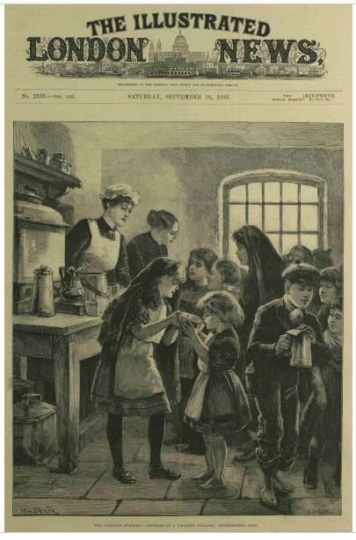
Hunger?
Notes:
Front page of The Illustrated London News, 16 September 1893.

Slide 29
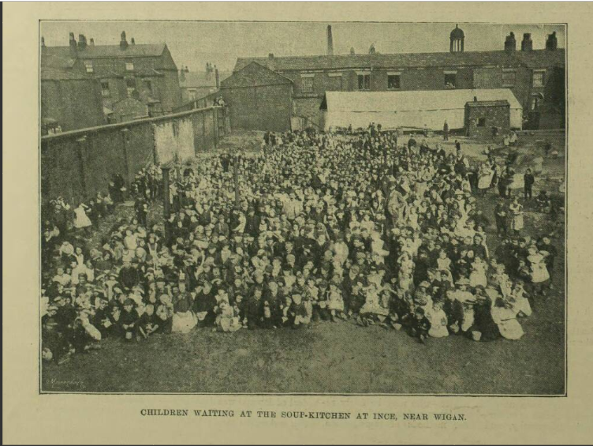
David Nicoll, Bullets for Bread, 1895
Crowds are ‘starving’, ‘famished’, ‘driven mad with hunger’.
Children waiting at the soup-kitchen at Ince, nr. Wigan, Lancashire, Illustrated London News, 30 September, 1893.
Notes:
D. J. Nicoll, Bullets for Bread!: The Featherstone Massacre (Sheffield, David Nicoll: c. 1895) (copy, Featherstone Public Library). David John Nicoll (1860-1919) joined the Socialist League in 1885 and became a prominent outdoor propagandist. He became an assistant editor of Commonweal in 1889 under William Morris, then editor in 1890 by which time he was clearly identified with the anarchist wing of the SL. He was convicted in 1892 of incitement to murder after writing and publishing an article in Commonweal, violently critical of the Home Secretary, and making an inflammatory speech in Hyde Park and was sentenced to 18 months’ imprisonment with hard labour. After his release he moved to Sheffield where he started the Anarchist, a journal, and published various pamphlets, including Bullets for Bread. He died in obscurity in 1919.
The photo shows children waiting at the soup-kitchen at Ince, near Wigan. From ‘The Colliery Strikes: Distress in the Lancashire Colliery Districts’, Illustrated London News, 30 Sep, 1893. ‘[M]any of the miners and their families are on the verge of starvation.’ ‘The … illustration shows the women and children waiting at a soup kitchen, which is conducted by Inspector Jump, of the Lancashire County Police Force, and a committee formed of tradesmen, a clergyman, the parish priest, and workmen living in the neighbourhood. The kitchen and dining rooms consist of three old warehouses and a canvas tent; and in these places about 2,000 children, from the ages of two years to thirteen, are fed daily with either rice and milk, or potato hash pea-soup and broth and bread. Besides these about a thousand women receive daily a loaf and a quart of soup or broth.’

Slide 30
Sam Wood, The Battle of ’93
‘[E]very day many were brought face to face with starvation’.
Men saw that they were to be starved into submission ‘whereupon a spirit of hostility at once rose up in their midst’.
The Manchester Guardian:
The van of the attack on Ackton Hall Colliery ‘was composed of women, who urged on the men with a kind of feminine savagery, made more eager by hunger and a brooding over their supposed wrongs’ (11 September 1893).
Bodily injury and the humiliation of begging, charity.

Slide 31
From
Amicable Understanding to
Tear him from Limb to Limb!
Anger & Reason in the English Coal Lock-out of 1893
Quentin Outram, University of Leeds, UK
qo@lubs.leeds.ac.uk
Notes:
Cover: Minerva trattiene Achille dall'uccidere Agamennone [Minerva [Athena] restrains Achilles from killing Agamemnon], known in English as The Rage of Achilles (detail), Tiepolo, 1757. A fresco at the Villa Valmarana ‘Ai Nani’, Vicenza. The painting depicts the scene in Homer’s Iliad showing the confrontation between King Agamemnon (left) and Achilles (right), when the enraged Achilles draws his sword from his sheath as he contemplates killing Agamemnon but is restrained by the goddess Athena, known to the Romans as Minerva, who seizes him by his hair (The Iliad, book 1, lines 119-372, at line 232). Often interpreted by translators and commentators as an example of Homer’s use of godly intervention to metamorphose and externalize internal mental and emotional conflicts (George Chapman, Alexander Pope), Barbara Koziak has suggested that Homer saw no split between emotion and reason (‘Homeric Thumos: The Early History of Gender, Emotion, and Politics’, Journal of Politics, 61(4), November 1999, pp. 1068-91, at p. 1077.

Slide 32
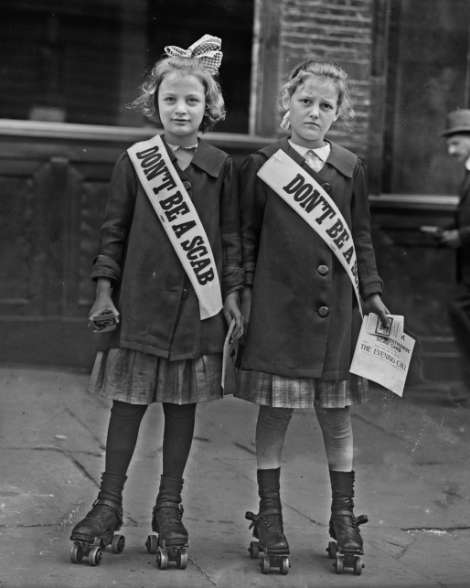
INSULTS
& Provocations
Notes:
A news photo from a US strike c. 1915-20, possibly the 1916 Atlanta streetcar strike? An anonymous posting to the Corvusfugit website (https://corvusfugit.com/2017/07/16/1916-dont-be-a-scab/) suggests the New York transit workers strike of the same year
Digital ID: (digital file from original neg.) ggbain 22868 http://hdl.loc.gov/loc.pnp/ggbain.22868
Reproduction Number: LC-DIG-ggbain-22868 (digital file from original negative)
Repository: Library of Congress Prints and Photographs Division Washington, D.C. 20540 USA http://hdl.loc.gov/loc.pnp/pp.print

Slide 33
,
‘Provocations’ by
Strike Breakers, ‘Blacklegs’
Dewsbury, 31 July, 1 August:
Leeds Mercury
A crowd of 2,000 to 3,000 men and lads ‘besides many women’, gathered round the pits and launched ‘a furious attack with sticks and stones and pieces of coal’ on the working miners
(2 August 1893).
Notes:
Crowds paraded the Dewsbury district, hooting and attacking non-unionists on 31 July. The next day, a crowd estimated at 4,000 people in one report, at between 2,000 and 3,000 men and lads ‘besides many women’ in another, gathered round the pits to greet the working miners as they came off their shift and launched ‘a furious attack with sticks and stones and pieces of coal’. At the Hoyland Silkstone Collieries the colliery’s coke-oven workers and some non-union labourers were threatened, sometimes at their houses, and in one case beaten, in order to make them cease work. The week concluded with an attack on a train working colliery traffic to the mainline by ‘a large gang of rough lads’. The company hired counsel to represent working miners bringing charges of assault. In the second week of August, men filling coal were pelted with stones at Aldwarke Main Colliery. The same week saw tense scenes at the Whinney Moor Pit, near Wakefield. The company had not wanted to reduce wages and had not locked-out their miners. The miners then decided to give notice of a strike ‘so as to be on an equal footing with the other miners who have come out’, but the company made difficulties with the result that the notice was tendered late and the miners carried on working till the 10 August. When they left work on that day, they found a large crowd of miners waiting for them. Each had a stone in his hand. The Whinney Moor miners were surrounded and ‘interviewed’, as others cried ‘Baa, baa’, like sheep bleating, meaning ‘black sheep’, or ‘black legs’. The Whinney Moor miners were allowed to go on their way, and no violence occurred.
The following week, the Eastmoor district of Wakefield, only five or six miles west of Featherstone, saw a series of disturbances arising out of the relations between the mass of the miners and five men: Cornelius Hole and James Pounder, who were non-unionists, and Edward Parkinson and his two sons, Sam and George, who had been expelled from the local branch of the Yorkshire Miners’ Association a few months before. All five men were employed by the company in maintenance work while the lock-out continued. On 14 August, at about 9:00 p.m., the homes of the five men were attacked by a crowd of several hundred men, women and children. All the windows at the front of the Holes’s house were smashed; there were eight children in the house at the time. Mrs Hole, interviewed by the press stated that ‘They have threatened to kill him [her husband] tonight’. Mrs Pounder retailed a similar story: ‘They yelled and hooted so loud that they could be heard three miles away’. So, too, did the Parkinsons. Sam Parkinson told the reporter ‘[a]t the time of the attack … “the youngster was in bed, and the wife had [to go] upstairs and fetch her down. Then we had to crouch behind the door, while half-bricks were hurled at it.” ’ The district was said to be in ‘a state of great ferment’ with much indignation evinced towards Cornelius Hole who at first continued to work despite the threats against him.
(Sources: ‘The Collier’s Lockout’, Reynold’s Newspaper [London], 6 August 1893, p. 8a (quotation; 4,000); ‘The Coal Trade Crisis’, The Leeds Mercury, 2 August 1893, p. 8d (2,000 or 3,000); ‘The Coal Trade Crisis’, The Barnsley Chronicle, 5 August 1893, p. 8d, referring to events on 28-31 July and 1-2 August, 1893; ‘Alleged Intimidation at Hoyland Silkstone’, The Barnsley Chronicle, 19 August 1893, p. 5c; ‘The Coal Trade Crisis: Yorkshire’, The Barnsley Chronicle, 12 August 1893, p. 8d; ‘The Coal Crisis: Rowdyism at Eastmoor: Five Houses Wrecked: Inmates Injured’, Pontefract and Castleford Express, 19 August 1893, p. 3a.)

Slide 34
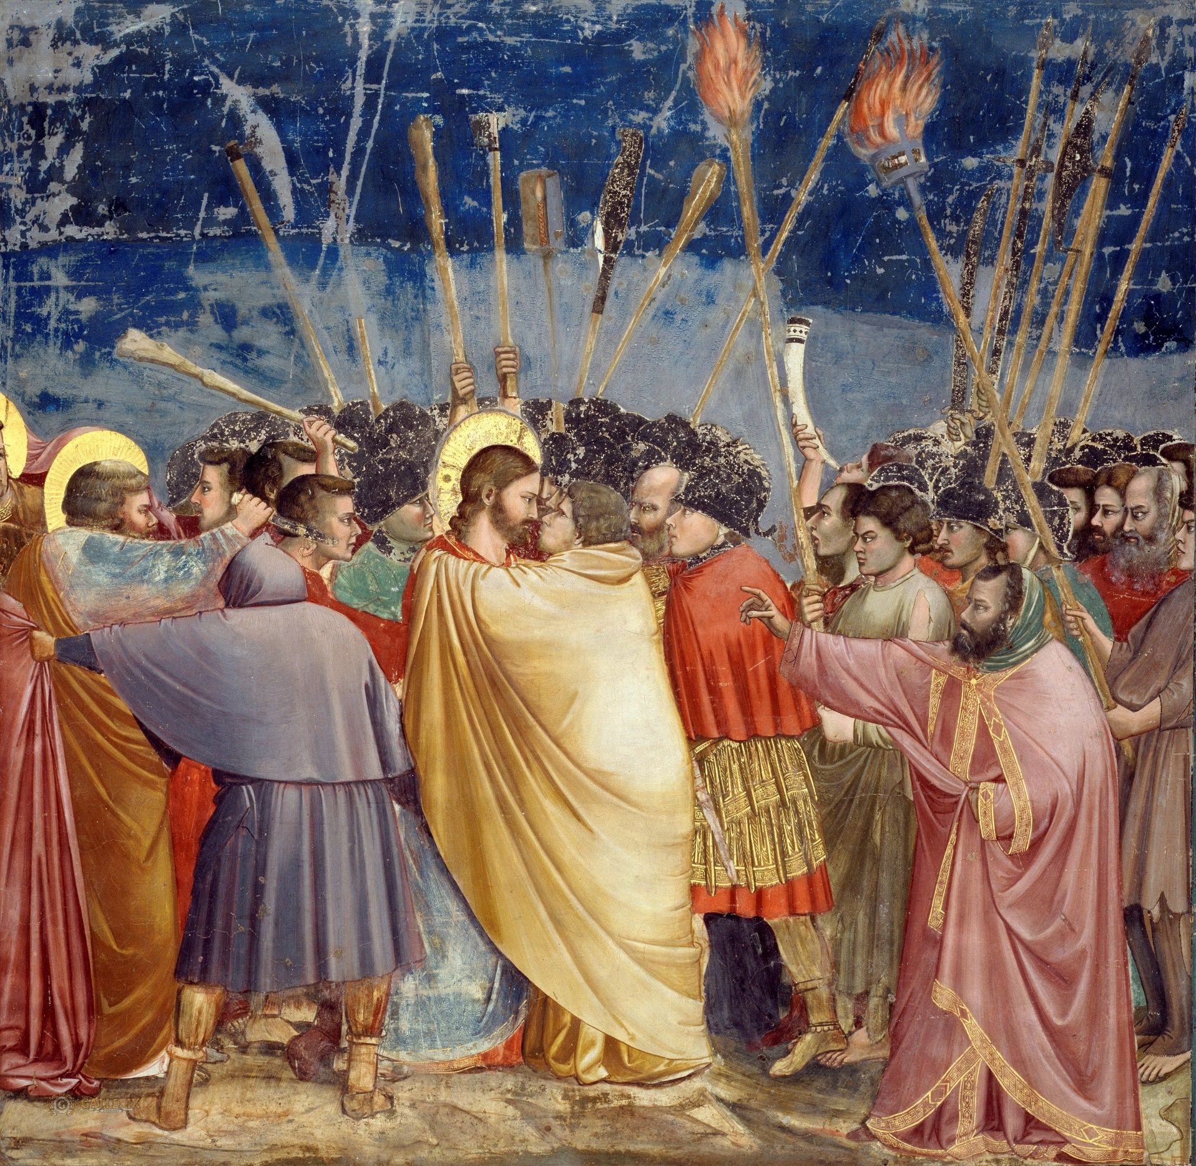
Blacklegging as a betrayal
Notes:
Giotto di Bondone (d. 1337): The Arrest of Christ (also known as the Kiss of Judas), fresco, between 1304 and 1306. (Height: 200 cm; Width: 185 cm). Scrovegni Chapel, Padua, Italy. Public domain.

Slide 35
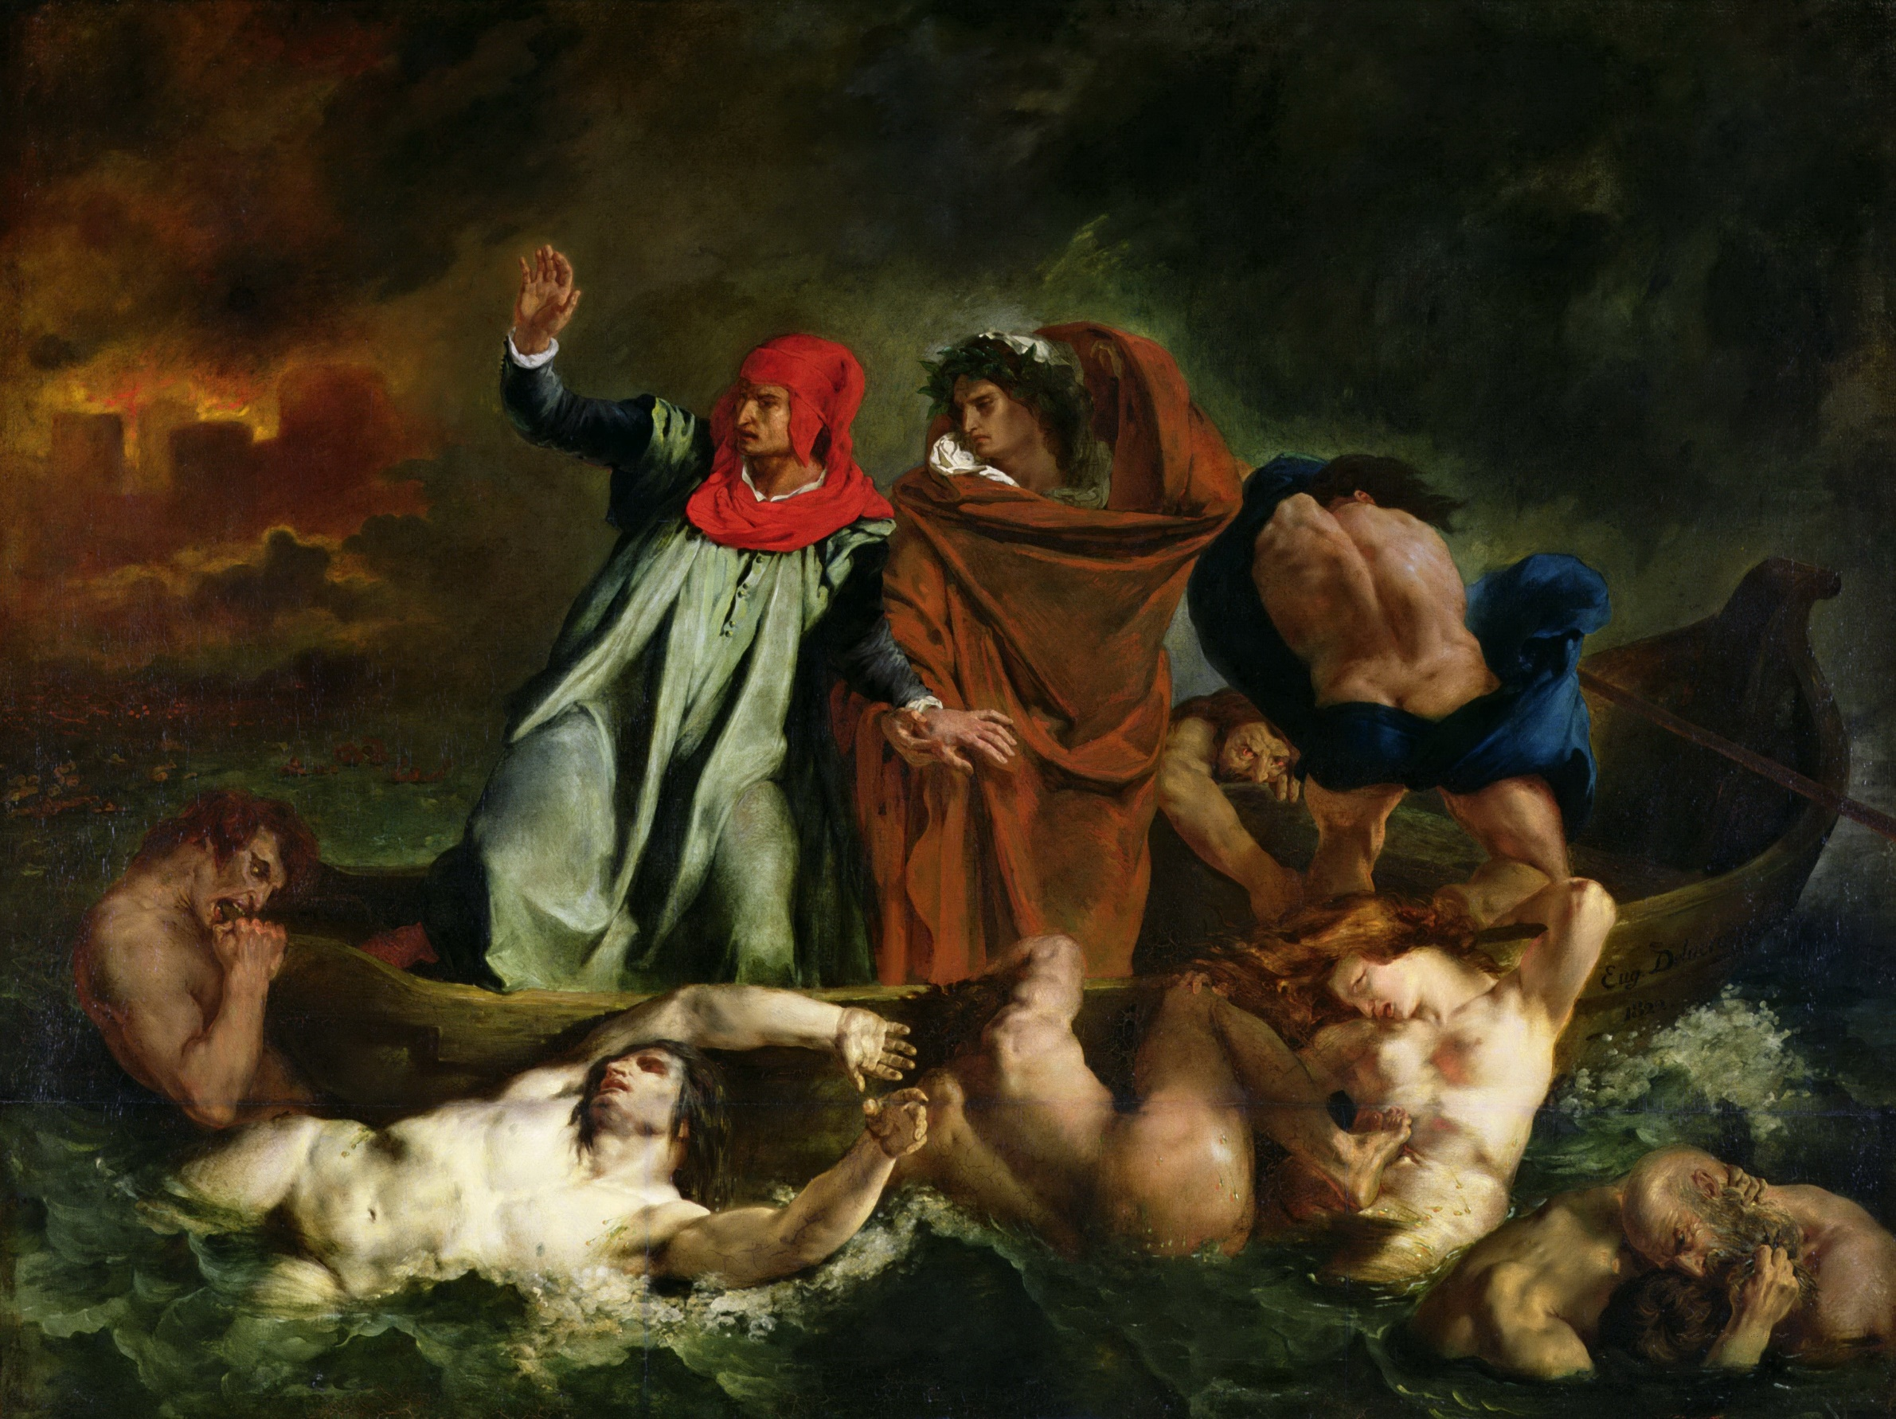
Dante and Virgil cross the River or Marsh of Styx, ferried by the oarsman Phlegyas, to the Fifth Circle of Hell where the wrathful and sullen lie.
Dante, Inferno, Canto VII. Delacroix, The Barque of Dante, 1822.
Blacklegging as treason.
The Lowest Circle of Hell
Notes:
Dante and Virgil cross the Fifth Circle. Dorothy L. Sayers writes: ‘the active hatreds rend and snarl at one another; at the bottom, the sullen hatreds lie gurgling, unable even to express themselves for the rage that chokes them’ (The Comedy of Dante Alighieri the Florentine: Cantica I: Hell, Penguin Books, Harmondsworth, 1949, notes on Canto VII, p. 114). The Ninth Circle is described in Cantos XXXII to XXXIV. It is for sinners guilty of treachery and is divided into four concentric rings or rounds in the form of a frozen lake, ‘Cocytus’. To take them in order, from least serious to most serious: Round 1 is Caina, named after Cain, for those who were traitors to their kin; Round 2 is Antenora, named after Antenor who betrayed Troy to the Greeks, for traitors to their country; Round 3 is Ptolomea, named after the Ptolemy, who was Governor of Jericho, that is the Ptolemy of 1 Maccabees 16, who invited his father in law to a feast and there killed him, for traitors to their guests; Round 4 is Judecca, named after Judas Iscariot, for traitors to their lords.

Slide 36

Blacklegging as treason.
The Lowest Circle of Hell
John Ciardi, the American poet, wrote: ‘The treacheries of these souls were denials of love (which is God) and of all human warmth. … As they denied God’s love, so are they furthest removed from the light and warmth of his Sun. As they denied all human ties, so are they bound only by the unyielding ice
Notes:
John Ciardi (1916-1986). The Inferno, originally published by Rutgers University Press, New Brunswick, NJ, 1954, the quotation here is from the Signet Classics edition published by the New American Library division of Penguin Books, New York, 2009, introductory notes on Canto XXXII, p. 259.

Slide 37
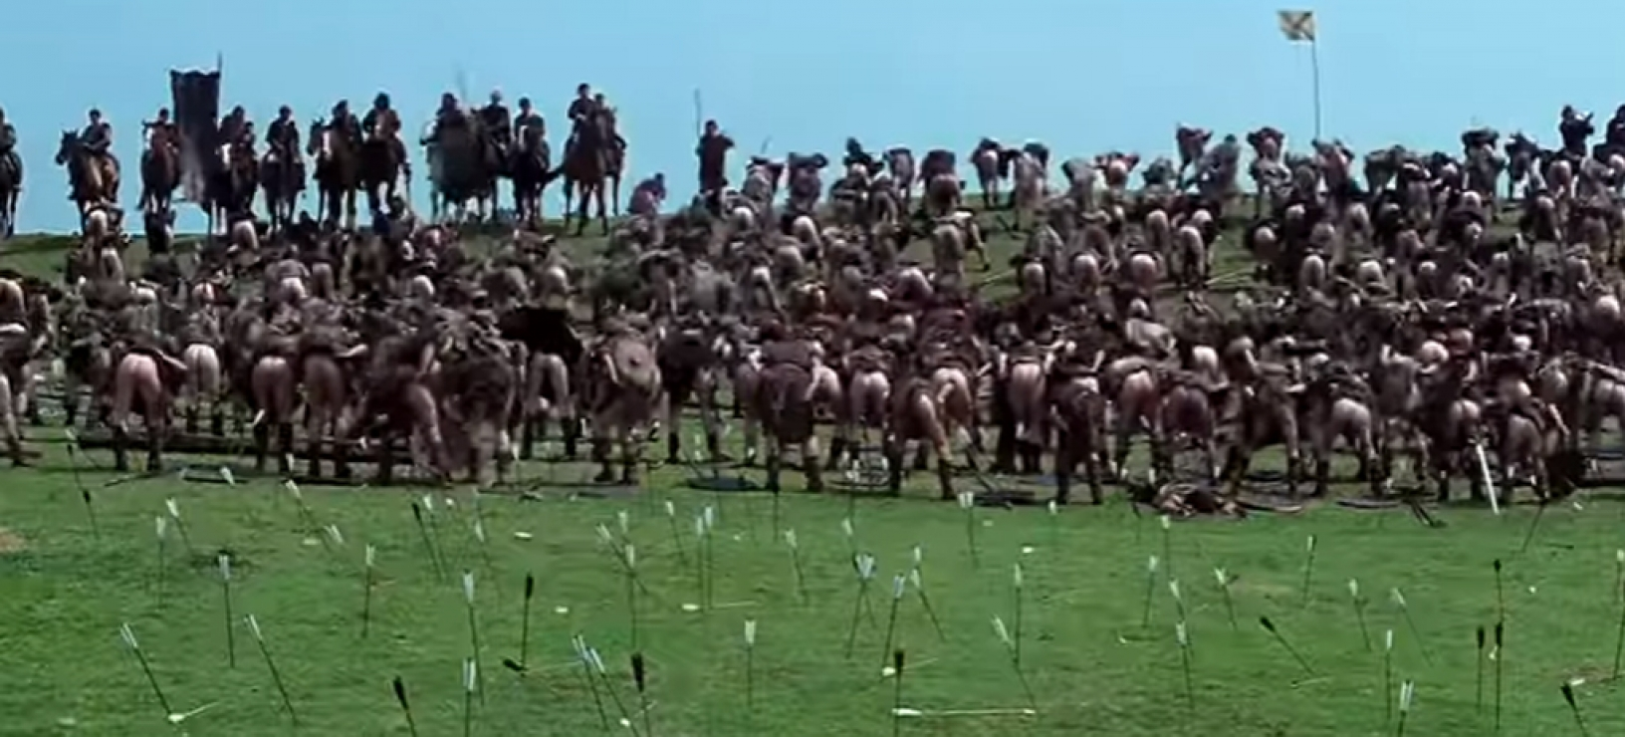
A Narrative of Provocation

Slide 38
Provocation: Smudge and Lies at Ackton Hall Cy, Featherstone
Surface workers still at work;
loaded ‘smudge’ into railway trucks; some sold.
Tuesday 5 September:
A ‘marching gang’ of men, women and lads, armed with sticks and cudgels, told the surface workers:
  If you don’t give over we’ll knock y[our] bloody ribs in.
The men stopped work and ran off.
Notes:
Sources: Report, Police Sergeant Sparrow to Inspector Prosser, 1:15 p.m., 5 September 1893 in NA HO 144/253/A55059K (1-112), item 82; Holiday, deposition to Treasury Solicitor, 25 September, in NA TS18/1407, p. 25; William Henry Jaques, a surface foreman, undated deposition to Treasury Solicitor, in NA TS18/1407, p. 49 (quotation); Bowen, Minutes, Qq. 420, 437 (Holiday), Qq. 2,399-2,410.

Slide 39
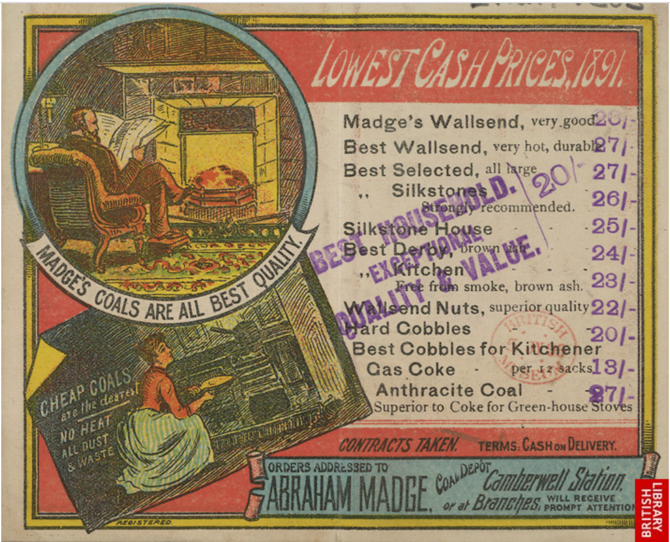
Smudge?
An advertisement for Abraham Madge, Coal Merchants, Camberwell, London, 1891.
Evanion Collection of Ephemera, British Library, London.
Available online at http://www.bl.uk/onlinegallery/onlineex/evancoll/a/largeimage72370.html
Domestic coal was normally sold by provenance (“Wallsend”, “Silkstone”) and size (“all large”, “nuts,” and “cobbles”).
Below these grades were “slack” and “smudge”.
“CHEAP COALS are the dearest.
NO HEAT ALL DUST & WASTE”

Slide 40
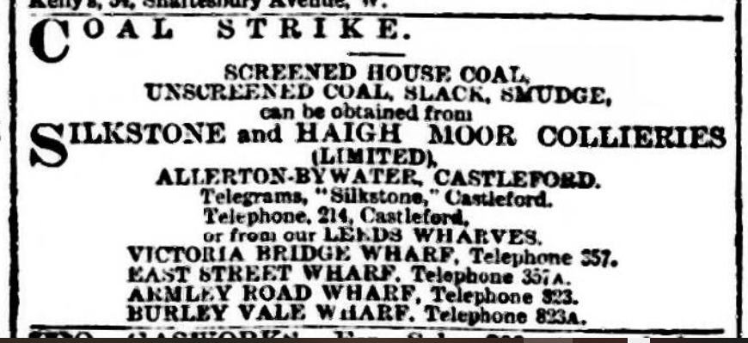
During the lockout, slack and smudge could find a market
Yorkshire Post and Leeds Intelligencer, 26 August 1893.
SCREENED HOUSE COAL,
UNSCREENED COAL, SLACK, SMUDGE

Slide 41
Provocation: Smudge and Lies at Ackton Hall Cy, Featherstone
Wednesday 6 September: Early
Ackton Hall miners met with the manager, A. J. Holiday. They said: The loading of coal for sale was generating
  ‘a very strong feeling among the miners’.
It would be
‘difficult to restrain further violent proceedings’.
Holiday promises to stop loading smudge for sale.
Notes:
Source: Bowen Inquiry, Minutes, Qq 431-6 (Holiday).

Slide 42
Provocation: Smudge and Lies at Ackton Hall Cy, Featherstone
Wednesday 6 September: Later
Surface workers surrounded by a crowd armed with sticks,
  ‘men and boys and women and all’
who insisted they cease work.
Used ‘very strong’ language to the foreman, William Jaques: if he went near the smudge again they would
  ‘tear him from limb to limb’.
That night: Jaques and his wife were assaulted.
Notes:
Sources: Jaques, undated deposition to Treasury Solicitor, in NA TS18/1407, pp. 50-1; Bowen, Minutes, Qq. 2446-66 (Jaques).

Slide 43
Provocation: Smudge and Lies at Ackton Hall Cy, Featherstone
Thursday 7 September:
A group of women enter the yard and insist all work should stop; joined by a group of youths, armed.
They told Holiday he had broken their agreement. Two wagons of smudge were ticketed to Bradford.
Holiday: the tickets are old ones;
I have kept my promise.
Coal wagons overturned; windows broken. Holiday goes to fetch police. There are no police, only soldiers.

Slide 44
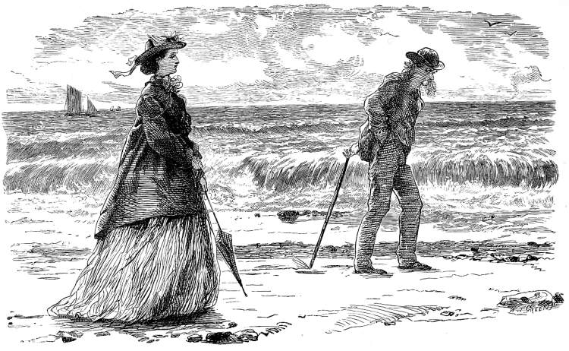
Marcus Stone, The Happy Pair. Wood engraving by W. T. Green. Illustration for Charles Dickens, Our Mutual Friend, Ch. 10, ‘A Marriage Contract’,
Interlude: Lies and Humiliation.
Mr and Mrs Lammle, each having married under the impression that the other is rich, discover that each is poor.
Both are humiliated by the other’s deception; she is angry; he, livid.

Slide 45
Narrative:
The Soldiers at Ackton Hall
28 infantry o/c Capt. Digby Barker.
Arrive at 4:00. Jeered & hooted.
No JP. Hide in the Engine House.
6:30 Holiday asked to remove soldiers; refuses. A crowd of thousands gathers. Holiday again asked to remove soldiers.
Amos White’s crowd arrives. Again Holiday asked to remove soldiers.
Then several shouted:
‘Kill him [Holiday]! Kill the bugger while you have him!’
Notes:
Holiday gave ‘Now we’ve got the bugger let’s kill him’, in his deposition to the Treasury Solicitor, 25 September, in NA TS18/1407, pp. 32-3, and reported similarly to the Bowen Committee, Minutes, Q. 567. Police Sergeant Sparrow gave ‘Into the b---. Kill the b---- now you have them’ in his Report to Headquarters, Wakefield, 27 September 1893, in ‘Copy letters, etc., Produced by Mr. Gill, WRCC Solicitor’s papers WRD1/37/3/18, p. 95; ‘Give the bugger it now you have him! kill him’ in his deposition to the Treasury Solicitor, 28 September, in NA TS18/1407, p. 90; and two slightly different versions to the Bowen Committee: ‘Give the b---- it, now you have him! Kill him!’ (Minutes, Q. 293) and later ‘Go for him’ and ‘Kill the b----’; (Q. 1124). Corden gave ‘No, kill the bugger whilst you have him’ in his deposition of 12 September 1893, WRCC Solicitor’s papers, Wakefield RO, WRD1/37/2/1; the quotation is from Corden’s deposition to Treasury Solicitor, 25 September, in NA TS18/1407, p. 80; he gave ‘Kill the b--- while you have him’ to the Bowen Committee (Minutes, Q. 1590).

Slide 46
Narrative:
The Soldiers at Ackton Hall
About 7:00: The colliery yard set alight. Capt. Barker approached in the Engine House by six men: Leave or we shall burn you out.
Barker: I’ll go if the crowd goes.
He goes to station but crowds remain.
About 8:00: Bernard Hartley JP arrives. The troops are marched back to yard.
Crowd told to disperse. It does not.
About 8:40: Riot Act read.
About 9:15 Hartley orders troops to fire, twice. Duggan and Gibbs killed. Crowd still remains.
Notes:
Sources: Capt. Barker, Report, 7th September; Deposition of Digby Hilliard Barker, 9 September 1893, WRCC Solicitor’s papers, Wakefield RO, WRD1/37/2/1; Barker’s verbal evidence to Gibbs’s inquest as reported in ‘Inquests on the Victims’, The Leeds Mercury, 11 September 1893, cutting in NA HO 144/253/A55059K (1-112), item 82; Barker, deposition to Treasury Solicitor, 24 September, in NA TS18/1407.
Bowen, Report, Minutes, where James Duggan is referred to as ‘James Duggin’.
Police Inspector Corden, deposition to Treasury Solicitor, 25 September, in NA TS18/1407.
Bernard Hartley, JP, 9 September 1893, Deposition, WRCC Solicitor’s papers, Wakefield RO, WRD1/37/2/1; verbal evidence of Hartley at Gibbs’s inquest, The Leeds Mercury, 11 September 1893; undated deposition to the Treasury Solicitor in NA TS18/1407; his evidence to Bowen, Report, Minutes.
Police Sergeant Sparrow, deposition to Treasury Solicitor, 28 September, in NA TS18/1407.
A. J. Holiday, depositions to Treasury Solicitor, one undated and one of 25 September, in NA TS18/1407; verbal evidence of Holiday at Gibbs’s inquest, The Leeds Mercury, 11 September 1893, cutting in NA HO 144/253/A55059K (1-112), item 82, and The Leeds Mercury, 13 September 1893; his evidence to Bowen Minutes.
The reporters Walter Smithers (deposition to Treasury Solicitor, 28 September, in NA TS18/1407; Bowen, Minutes) and an unnamed reporter from the London Daily News, himself apparently relying on an interview with Holiday on 10 September (‘The Coal Trade Struggle’, The Daily News [London], 11 September 1893, p. 5e).
‘The Riots at Ackton Hall Colliery’, Yorkshire Post, 11 September; ‘The Miners’ Strike: Ackton Hall Colliery Riots’, Yorkshire Post, 14 September 1893.

Slide 47
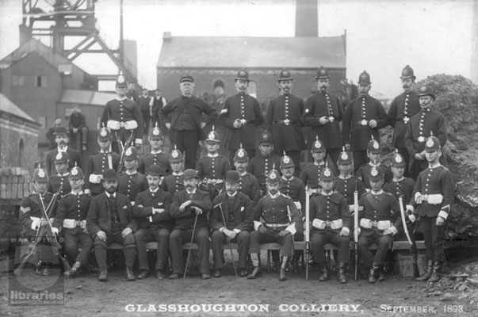
INSULTS
& Provocations

Slide 48
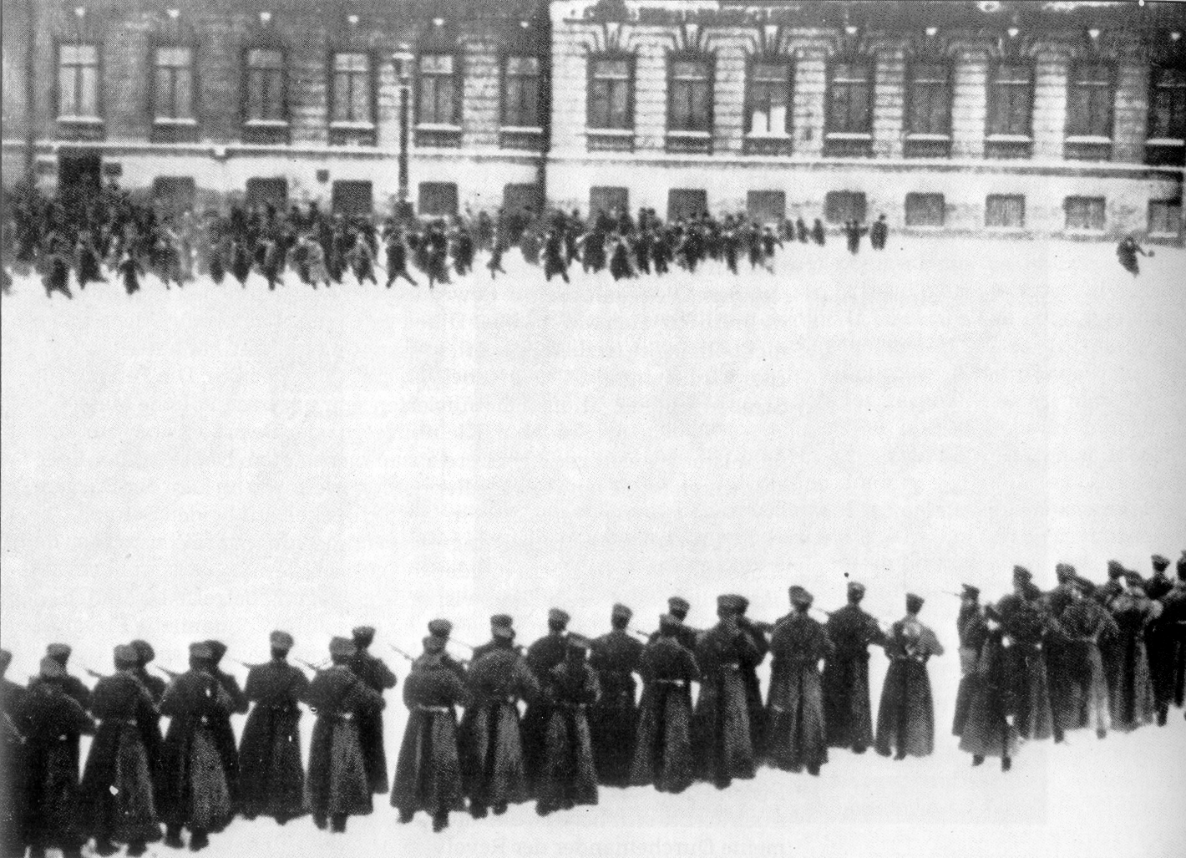
Provocation:
the presence of police and soldiers,
an ‘irritation to a free people’.
Still from the film Dvyatoe yanvarya [Ninth of January], dir. Vyacheslav Viskovsky (1881-1933), 1925.
‘Bloody Sunday’ 1905
Troops fire on demonstrators at the Winter Palace, St Petersburg
Notes:
‘Bloody Sunday’: Unarmed demonstrators seeking to present a petition to the Czar were fired upon by soldiers of the Imperial Guard as they marched towards the Winter Palace. The outrage led to a series of strikes that is usually taken to be the start of the 1905 Revolution.
Although this post-dates the ‘Featherstone Massacre’, British attitudes to Russia on both left and right had long been that it was a tyranny. See for example the report in the Manchester Evening News for 6 April 1893 of Russia’s measures to suppress a religious sect called the Stundists (now usually ‘Shtundists’): the headline was simply ‘Tyranny in Russia’.

Slide 49
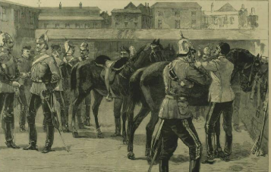
Provocation:
the presence of police and soldiers,
an ‘irritation to a free people’.
The Yorkshire Factory Times:
The military have gone from Dewsbury.
It … was a mistake for them to be there
at all, as it was an
INSULT OF THE DEEPEST CHARACTER
‘Arrival of the Dragoon Guards at Wakefield’,
Illustrated London News, 16 September 1893

Slide 50
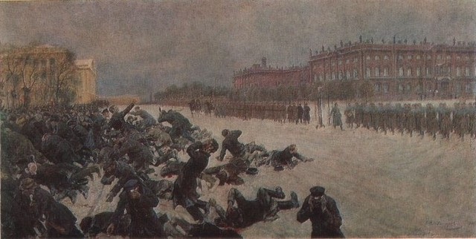
Provocation:
the presence of police and soldiers,
an ‘irritation to a free people’.
The Yorkshire Factory Times:
The mounted police were hanging
around the Co-op. Hall while the miners’
meeting was going on. The … presence
of a mounted police force was an
INSULT TO THE PEACEABLE
INHABITANTS.
Notes:
Ivan Vladimirov, Расстрел на Дворцовой площади 9 января 1905 года [Bloody Sunday. Shooting workers near the Winter Palace January 9, 1905]. Online at https://www.wikiart.org/en/ivan-vladimirov/bloody-sunday-shooting-workers-near-the-winter-palace-january-9-1905-1 (Accessed 28 July 2021).

Slide 51
Henri Jean-Baptiste Victoire Fradelle (1778–1865),
'Othello', Act I, Scene 3, Othello Relating His Life Story to Desdemona c.1823–1824.
Photo credit: François Grosjean. Royal Shakespeare Company Collection
Narrative

Slide 52
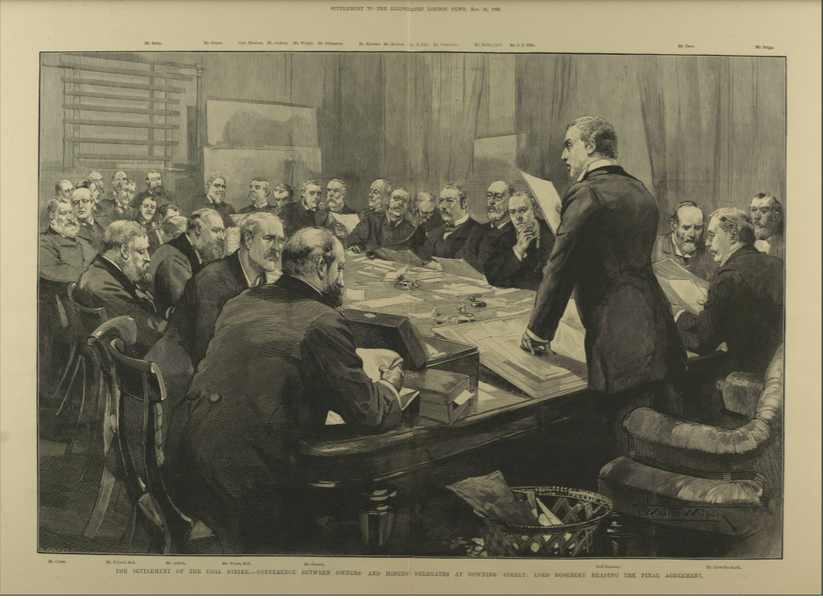
Afterwards
The activities of the marching bands were checked by the shock of the shootings at Featherstone but the lock-out continued and hunger deepened. Eventually, in mid-November, a conference convened by the Prime Minister and chaired by the Foreign Secretary, the Earl of Rosebery, took place.
Notes:
Illustration from the Illustrated London News, 103 (2849), 25 November 1893, p. 18. Rosebery is standing to read out the final terms of settlement. The miners’ representatives are to his left, the owners’ to his right. The Illustrated London News states that the conference was in No. 10, Downing St. In fact, it was in the more opulent and imposing surroundings of the Foreign Office, said by some to have had a material effect on the mood of some of the men present.

Slide 53
Afterwards
Sam Wood:
“Towards the end of this eventful day [17 November] men and women gathered in groups about the villages and towns, talking and waiting for the news. Presently there was a great stir on every hand: the telegraph had flashed its welcome message throughout the country, ‘Peace with honour; the men to restart work at once at the old rate of wages!’
“There was boundless enthusiasm in every colliery district. The victory of Waterloo was nothing to this, and the thousands who had suffered so long and so severely were almost beside themselves with joy.”

Slide 54
What about the Women?
Paula Rego, Angel, 1998. Reproduced in Anthony Spira and Catherine Lampert (eds.), Paul Rego: Obedience and Defiance, Art/Books, 2019

Slide 55
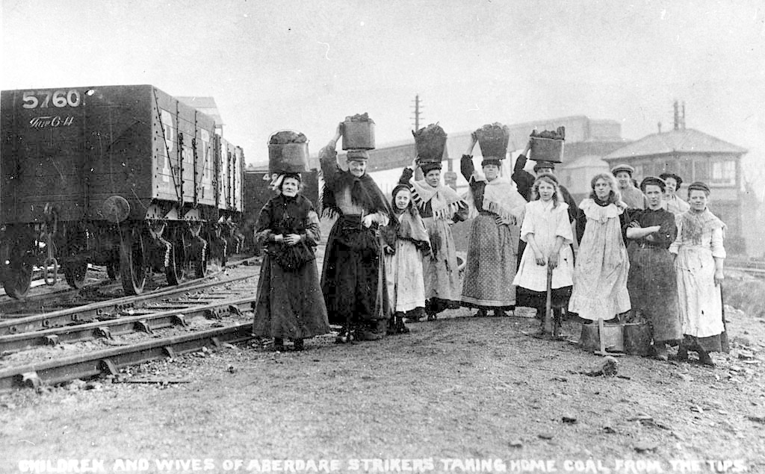
Women in the Lockout
Children and wives of Aberdare Miners gathering coal from the waste tips during a strike in 1910.
Women appear as “miners’ wives”
Women banned from working underground in 1842; a few work on the surface, mainly in Lancashire.
Present in action
Almost absent in reported speech
United with men in feeling?
But tears allowed.
Notes:
Reports: The Greenock Telegraph and Clyde Shipping Gazette, Wednesday, 8 November, 1893.
(An ad hoc women’s support meeting took place in St. James’s Hall, London, 7 November. The attenders were mainly middle (and upper) class but included two miners’ wives. It was chaired by Beatrice Webb.)

Slide 56
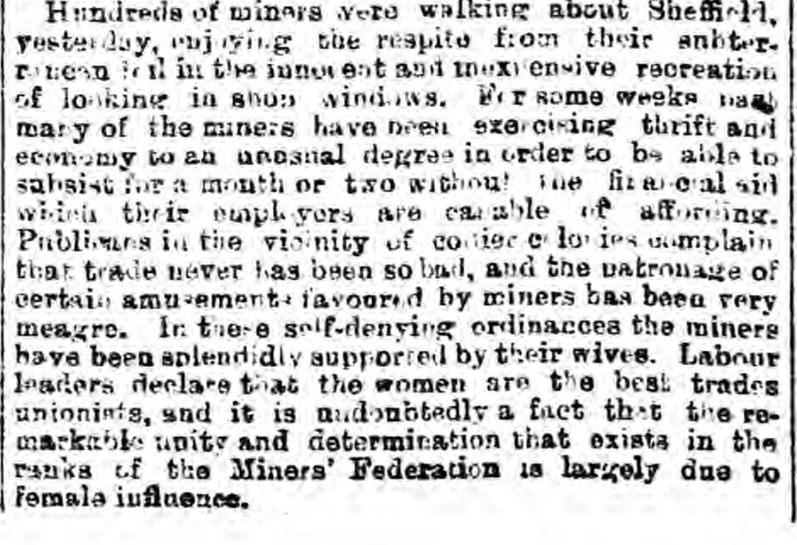
Women in the Lockout
The Sheffield & Rotherham Independent, 1 August 1893
‘…the miners have been splendidly supported by their wives. Labour leaders declare that women are the best trades unionists, and it is undoubtedly a fact that the remarkable unity and determination that exists in the ranks of the Miners’ Federation is largely due to female influence.’

Slide 57
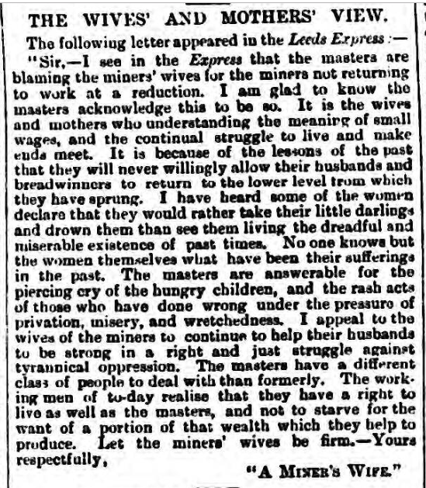
Women in the Lockout
‘A Miner’s Wife’:
‘I see … that the masters are blaming the miners’ wives for the miners not returning to work’. [They are quite right.]
The Wigan Observer and District Advertiser, 27 October 1893
‘The masters are answerable for the piercing cry of hungry children, and the rash acts of those [men] who have done wrong under the pressure of privation, misery, and wretchedness.’

Slide 58
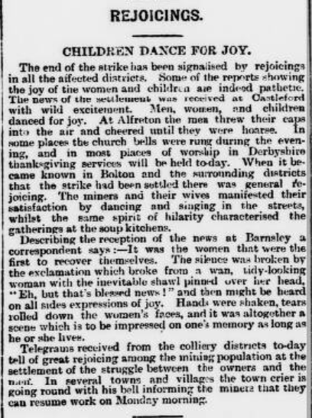
Women and Children
Notes:
Text (Yorkshire Evening Post, 18 November 1893): REJOICINGS. CHILDREN DANCE FOR JOY. The end of the strike has been signalized by rejoicings in all the affected districts. Some of the reports showing the joy of the women and children are indeed pathetic. [Emphasis QO, to point the classification of women with children in parts of this report.] The news of the settlement was received at Castleford with wild excitement. Men, women, and children danced for joy. At Alfreton the men threw their caps in the air and cheered until they were hoarse. In some places the church bells were rung during the evening, and in most places of worship in Derbyshire thanksgiving services will be held today. When it became known in Bolton and the surrounding districts that the strike had been settled there was general rejoicing. The miners and their wives manifested their satisfaction by dancing and singing in the streets, whilst the same spirit of hilarity characterized the gatherings at the soup kitchens.
Describing the reception of the news at Barnsley a correspondent says:- It was the women that were the first to recover themselves. The silence was broken by the exclamation which broke from a wan, tidy-looking woman with the inevitable shawl pinned over her head, “Eh, but that’s blessed news!” and then might be heard on all sides expressions of joy. Hands were shaken, tears rolled down the women’s faces, and it was altogether a scene which is to be impressed on one’s memory as long as he or she lives.
Telegrams received from the colliery districts to-day tell of great rejoicing among the mining population at the settlement of the struggle between the owners and the men. In several towns and villages the town crier is going round with his bell informing the miners that they can resume work on Monday morning.

Slide 59
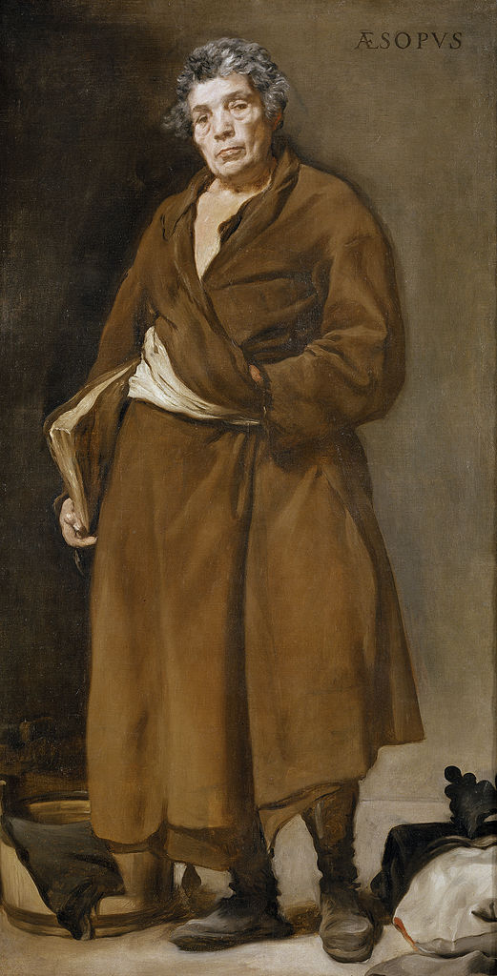
Summary
VelázquezAesop
Notes:
Velázquez, Aesop, c. 1638. Height 179 cm; width: 94 cm. Museo del Prado, Madrid.

Slide 60
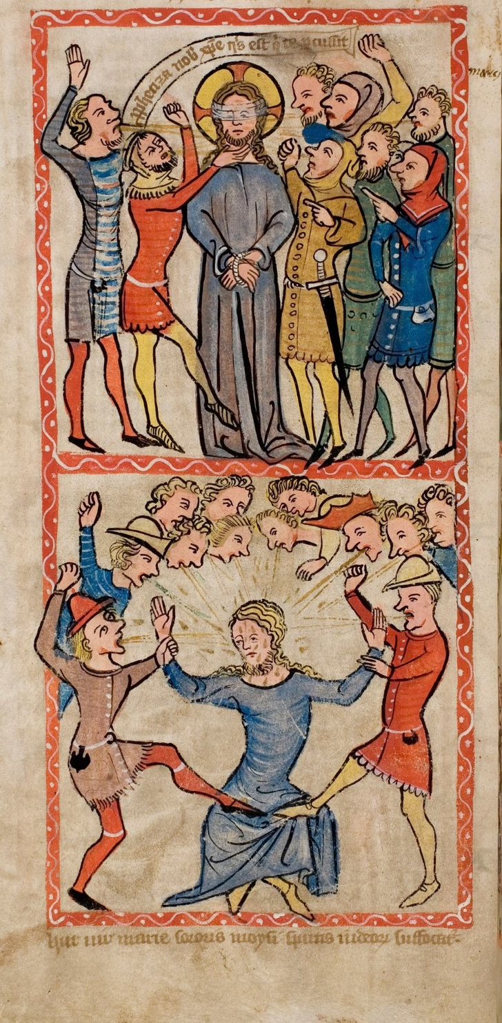
1. Why did the conflict turn violent?
Hunger
Managerial Lies
Police and Soldiers
All brought humiliations provocative of anger:
(Thomas J. Scheff).
Strike Breakers: betrayal, treason.
A denial of love, productive of anger and hatred.
Notes:
The Mocking of Christ in the Speculum Humanae Salvationis [The Mirror of Human Salvation] of c. 1360 (ULB Darmstadt). Covering the face, beating, spitting, mockery.

Slide 61
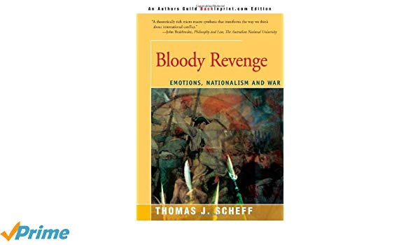

Slide 62
2. What happened to Reason?
Anger and violence seen in close conjunction with requests, negotiations, threats and violence
Requests to remove the soldiers
Negotiation with Holiday
A parley with Capt. Barker
Threats to surface workers
Threats and violence to William Jaques and his wife
Requests, negotiation, parleys and threats: all involve the use of reason.
Reason and emotion were compatible.
The lock-out settled by negotiation.

Slide 63
Women and Men
United with men in feeling?
But tears allowed.
Outside observers see women as comparable to children.
More ready to express emotions: tears, dancing in the streets.

Slide 64
Conclusions

Slide 65
Anger is not always incompatible with the use of reason and the pursuit of peaceful negotiation. There can be restraint in
angry human affairs.
Notes:
Tiepolo, The Rage of Achilles. To the left Agamemnon, right Achilles held back by Minerva/Athena pulling his hair.

Slide 66

UK Labour MP Jess Philips tells the PM she ‘will not sit and listen to her [Theresa May] crow about employment going up, when where I live employment is falling and hunger is rising’. She said she is ‘enraged’ with the PM’s ‘complete and utter lack of bravery’ on Brexit. The Guardian, 26 February 2019
Jess Philips MP,
angry but not, in fact, enraged,
but angry and rational.
Thank you
Notes:
See also: https://www.theguardian.com/books/2021/jul/18/jess-phillips-i-enjoy-feeling-angry-it-inspires-me and https://twitter.com/jessphillips/status/1266649401080123393?lang=en

